Slide 1
CUSTOMER RELATIONSHIP MANAGEMENT
CONCEPTS AND TECHNOLOGIES
Chapter 2: Understanding relationships

Slide 2
Defining ‘relationship’
A relationship is composed of a series of interactive episodes between parties over time.
Episodes are time bound (they have a beginning and an end) and are nameable.
Episodes are composed of a series of interactions. Interaction consists of action, and response to that action.
Is a relationship more than interaction-over-time?
  What about emotional content ? Do relationships have some type of affective connection, attachment or bond.

Slide 3
Relationships as social constructs
A relationship is a social construct.
  A relationship exists if people believe that a relationship exists and they act accordingly.
Relationships can be uni-lateral or reciprocal
  Either one, or both, parties may believe they are in a relationship.

Slide 4
Dwyer, Schurr & Oh’s model of relationship change
Awareness
Exploration
Expansion
Commitment
Dissolution

Slide 5
Major relationship attributes
Trust
Commitment

Slide 6
Types of trust
A party in a relationship may trust the other’s..
Benevolence. A belief that one party acts in the interests of the other.
Honesty. A belief that the other party’s word is reliable or credible.
Competence. A belief that the other party has the necessary expertise to perform as required.

Slide 7
How trust emerges
Trust emerges as parties share experiences, and interpret and assess each other’s motives.
As they learn more about each other, risk and doubt are reduced.
For these reasons, trust has been described as the glue that holds a relationship together across time and different episodes

Slide 8
How trust changes over time
Calculus-Based Trust is present in the early stages of a relationship and is quite calculative. It is as if one party says: “I trust you because of what I am gaining or expect to gain from the relationship.”
Knowledge-Based Trust relies on the parties’ interactive history and knowledge of each other, allowing each to make accurate predictions about the how the other will act.
Identification-Based Trust. This happens when mutual understanding is so deep that each can act as substitute for the other in interpersonal interaction.

Slide 9
Commitment defined
Commitment is shown by “an exchange partner believing that an ongoing relationship with another is so important as to warrant maximum effort to maintain it; that is, the committed party believes the relationship is worth working on to ensure that it endures indefinitely”.

Slide 10
Characteristics of commitment
Commitment arises from trust, shared values, and the belief that partners will be difficult to replace.
Commitment motivates partners to co-operate in order to preserve relationship investments.
Commitment means partners forgo short-term alternatives in favour of more stable, long-term benefits associated with current partners.
Commitment entails vulnerability, leaving partners open to opportunism.

Slide 11
Evidence of commitment
Evidence of commitment is found in the investments that one party makes in the other.
One party makes investments in the promising relationship and if the other responds, the relationship evolves and the partners become increasingly committed to doing business with each other.
Investments can include time, money, and the sidelining of current or alternative relationships.
A partner’s commitment to a relationship is directly represented in the size of the investment in the relationship, since these represent termination costs.

Slide 12
Attributes of high quality relationships
Core attributes
  Trust
  Commitment
Additional attributes
  Relationship satisfaction
  Mutual goals
  Cooperative norms

Slide 13
Companies want relationships with customers
Why?
  because companies that manage their customer base in order to identify, satisfy and retain profitable customers enjoy better business results
  reduced customer churn creates
    A larger customer base
    Longer average customer tenure
    Reduced marketing costs to replace defected customers
    Better understanding of customer requirements
    More cross-selling opportunities

Slide 14
Impact of churn on customer numbers
Year | Company A (5% churn) |  |  | Company B (10% churn)
 | Existing customers | New customers | Total customer base | Existing customers | New customers | Total customer base
2001 | 1000 | 100 | 1100 | 1000 | 100 | 1100
2002 | 1045 | 100 | 1145 | 990 | 100 | 1090
2003 | 1088 | 100 | 1188 | 981 | 100 | 1081
2004 | 1129 | 100 | 1229 | 973 | 100 | 1073
2005 | 1168 | 100 | 1268 | 966 | 100 | 1066

Slide 15
Connecting customer retention to customer tenure
Customer retention rate (%) | Average customer tenure
50 | 2 years
67 | 3 years
75 | 4 years
80 | 5 years
90 | 10 years
92 | 12.5 years
95 | 20 years
96 | 25 years
97 | 33.3 years
98 | 50 years
99 | 100 years

Slide 16
Organisational benefits from managing customer retention
Reduced marketing costs
  Fewer dollars need to be spent replacing churned customers
Better customer insight
  Suppliers are able to develop a better understanding of customer requirements and expectations. Customers also come to understand what a supplier can do for them.
  Consequently, suppliers become better placed to identify and satisfy customer requirements profitably, selling more product and service to the retained customer.
  Over time, as relationships deepen, trust and commitment between the parties is likely to grow, and revenue and profit streams from customers become more secure.

Slide 17
The Customer Journey
Suspect | Does the potential customer fit your target market profile?
Prospect | The customer fits the target market profile and is being approached for the first time.
First-time customer | The customer makes a first purchase.
Repeat customer | The customer makes additional purchases. Your offer plays a minor role in the customer’s portfolio.
Majority customer | The customer selects your company as supplier of choice. You occupy a significant place in the customer’s portfolio.
Loyal customer | The customer is resistant to switching suppliers, and has a strong positive attitude to your company or offer.
Advocate | The customer generates additional referral dollars through positive word-of-mouth.

Slide 18
Life-time value defined
Life-time value is the present day value of all net margins earned from a relationship with a customer, customer segment or cohort.
  To compute LTV, all historic net margins are compounded up to today’s value and all future net margins are discounted back to today’s value.
  Estimates of LTV potential look to the future only, and ignore the past.
  A customer that appears to be valuable on the basis of the gross margins generated will most likely be less profitable once cost-to-serve the customer is taken into account.

Slide 19
Four causes of profit margin growth over time
Revenues grow over time, as customers buy more.
Cost-to-serve is lower for existing customers, because both supplier and customer understand the other.
Referrals are generated by existing, satisfied customers through their unpaid advocacy.
Higher prices are paid by existing customers than new customers.

Slide 20
Customers are potential income streams
A core CRM idea is that a customer should not be viewed as a set of independent transactions but as a life-time income stream.

Slide 21
Customer life-time value
The total present day value of a customer is the sum of
  all past net margins compounded to today’s value, and
  all future net margins discounted to today’s value
The potential value of a customer is
  all future net margins discounted to today’s value

Slide 22
Profit over time - credit cards
profit per customer
60
40
20
0
-20
-40
-60
0
1
2
3
4
5
Year
Reichheld and Sasser HBR 90508

Slide 23
What you need to compute LTV
insight into future buying behaviour
  probabilities of buying products 1-n over the next x time periods
margins earned from those products
periodic costs of customer management
Plus, for new customers
costs of customer acquisition
And finally
Discount rate

Slide 24
The effect of discounting on customer value
Undiscounted profit over 5 years
Discounted profit over 5 years (15% discount rate)
Year 0 -$50
1 +$30
2 +$40
3 +$55
4 +$72
5 +$88
$235
Year 0 -$50.00
1 +$30/1.15 = +$26.09 2 +$40/1.15²= +$30.25 3 +$55/1.15³= +$36.16 4 +$72/1.15⁴= +$41.17 5 +$88/1.15⁵= +$43.76
$127.43
The net present value of 5- years profit earned from this customer is $127.43

Slide 25
Customer relationship value at US Bancorp
top tier, 11% of customers
threshold, next 22%
fence sitters, next 39%
value destroyers, bottom 28%

Slide 26
Cohort value: the impact of customer retention rate
Year Profit per NPV at Customer No. of Total annual
customer 15% discount retention rate Customers profit
(%)
0 -100 100,000 -10,000,000
1 50 43.48 60 60,000 2,608,800
2 70 52.93 70 42,000 2,223,062
3 100 65.75 75 31,500 2,071,125
4 140 80.00 80 25,200 2,016,000
5 190 94.53 85 21,420 2,024,776
6 250 108.23 90 19,278 2,086,364
7 320 120.30 92 17,736 2,133,654
8 400 130.72 94 16,672 2,179,346
9 450 127.84 95 15,838 2,024,744
10 500 123.15 96 15,204 1,872,372

Slide 27
Core strategies to improve cohort profitability
Improve customer retention rate in the early years of the relationship. This will produce a larger number of customers to generate higher profits in the later years.
Increase the profit earned per customer by
  Reducing cost-to-serve
  Cross-selling or up-selling additional products and services
Become better at customer acquisition by
  Using more cost effective recruitment channels
  Better qualification of prospects. Customers who defect early on perhaps should have not been recruited in the first place.

Slide 28
When do B2B companies not want relationships?
When they fear loss of control. Relationships are bi-lateral arrangements, which involve giving up unilateral control over resources.
When exits costs are high. Not all relationships survive. It is not necessarily easy or cost-effective to exit a relationship.
Resource commitment. Relationships require the commitment of scarce resources such as people, time and money.
When opportunity costs are high. If resources are committed to one customer realtionship, they cannot be used for another

Slide 29
Business customers want relationships when …..
the product or its applications are complex, for example, networking infrastructure
the product is strategically important or mission-critical, for example, core raw materials supply for a manufacturer
there are down-stream service requirements, for example, for machine tools
financial risk is high, for example, in buying large pieces of capital equipment
reciprocity is expected. A financial audit practice may want a close relationship with a management consultancy, so that each party may benefit from referrals by the other.

Slide 30
When do customers want relationships with suppliers?
In the B2C context, customers may value relationships for
several reasons:
Recognition. Customers may feel more valued when recognised and addressed by name.
Personalisation. Products or services can be customized.
Power. Relationships with suppliers can be empowering.
Risk reduction. A relationship can reduce, or even perhaps, eliminate perceived risk.
Status. Customers may feel that their status is enhanced by a relationship with a supplier.
Affiliation. People’s social needs can be met through commercially based, or non-commercially based, relationships.

Slide 31
Why B2B customers do NOT want relationships with suppliers
Fear of dependency
Lack of perceived value in the relationship
Lack of confidence in the supplier.
Customer lacks relational orientation
Rapid technological changes

Slide 32
The satisfaction-profit chain
Customer
satisfaction
Customer
loyalty
Business
performance
Understand customer requirements
Meet customer expectations
Deliver customer value
Revenue growth
Share of customer
Customer tenure

Slide 33
Customer satisfaction defined
Customer satisfaction is the customer’s fulfilment response to a customer experience, or some part thereof.

Slide 34

Loyalty

Slide 35
Two dimensions of customer loyalty
Behavioral loyalty
  Is the customer active?
  What is our share of customer spend
  RFM variables
    Recency
    Frequency
    Monetary value
Attitudinal loyalty
  Beliefs
  Commitment
  Preference
  Intention to buy

Slide 36
The satisfaction-profit chain
Customer
satisfaction
Customer
loyalty
Business
performance
Understand customer requirements
Meet customer expectations
Deliver customer value
Revenue growth
Share of customer
Customer tenure
Attitudinal loyalty
Behavioral loyalty

Slide 37
RFM measures behavioural loyalty
R = time elapsed since last purchase
F = number of purchases in a given time period
M = monetary value of purchases in a given time period

Slide 38
Loyalty squares
repeat purchase
high
low
true
loyalty
latent
loyalty
strong
attitude
spurious
loyalty
no
loyalty
weak

Slide 39
Share of market vs. share of customer
high
CRM
share of customer spend
Traditional marketing
low
few
many
Number of customers

Slide 40
Researching the satisfaction-profit chain
International data
National data
Industry data
Corporate data
Individual customer data

Slide 41
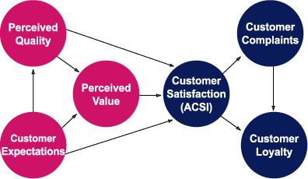
The American Customer Satisfaction Index (ACSI) model

Slide 42
Industry studies
Telecommunications
Banking
Airlines
Car distribution
Multi-industry

Slide 43
Returns from investments in customer satisfaction
High
repeat purchase rates
Low
1
2
3
4
5
6
7
not at all
satisfied
customer satisfaction level
very satisfied

Slide 44
Relationship management theory: 5 schools of thought
Industrial Marketing and Purchasing (IMP) school
Nordic school
Anglo-Australian school
North American school
Asian (guanxi) school

Slide 45
IMP school
Focuses on B2B context
Argues that B2B transactions occur within the context of broader, long-term relationships, which are, in turn, situated within a broader network of relationships.
Any single B2B relationship between supplier and customer is composed of activity links, actor bonds and resource ties

Slide 46
Actor bonds, activity links and resource ties
Actor bonds are interpersonal contacts between actors in partner firms that result in trust, commitment and adaptation between actors
Activity links are the commercial, technical, financial, administrative and other connections that are formed between companies in interaction
Resources are the human, financial, legal, physical, managerial, intellectual and other strengths or weaknesses of an organization

Slide 47
Nordic school
Emphasises the role of service in supplier-customer relationships
Identifies 3 major characteristics of commercial relationships - interaction, dialogue and value – known collectively as the “Triplet of Relationship Marketing”.

Slide 48
The Triplet of Marketing
Interaction
  Inter-firm exchanges occur in a broader context of ongoing interactions.
Dialogue
  Suppliers and customers are in dialogue with each other.
Value
  Value in relationships is mutual. To generate value from customers, companies need to generate customer-perceived value, that is, create and deliver something that is perceived to be of value to customers.

Slide 49
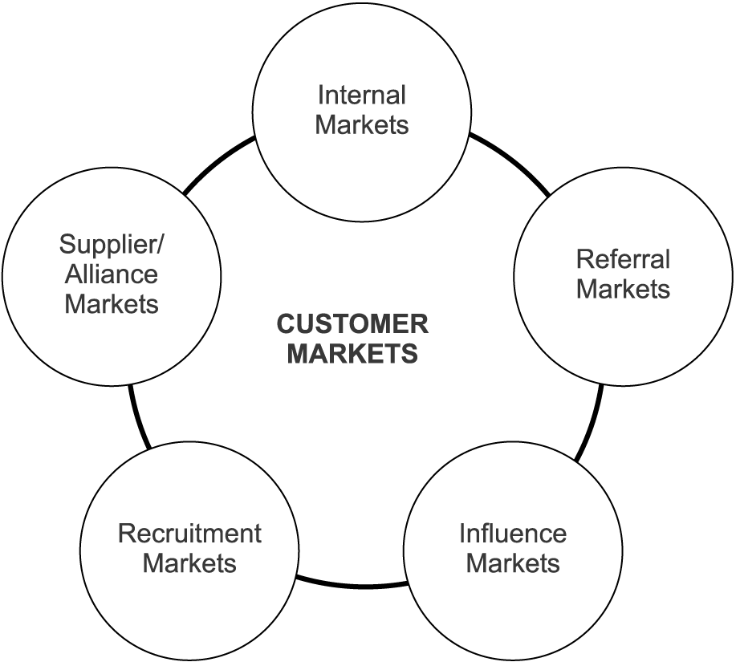
Anglo-Australian school 6-markets model

Slide 50
North American school
Links successful inter-firm relationships to excellent business performance.
Relationships reduce transaction costs
Focus on trust and commitment
View r elationships as tools that a well-run company can manipulate for competitive advantage.
Focus on dyadic relationships rather than networks.

Slide 51
Asian (Guanxi) School
The foundations of Guanxi are Buddhist and Confucian teachings regarding the conduct of inter-personal interactions.
Guanxi refers to the informal social bonds and reciprocal obligations between various actors that result from some common social context, for example families, friendships and clan memberships.
These are special types of relationship which impose reciprocal obligations to obtain resources through a continual cooperation and exchange of favours

